Slide 1

Quantitative Bias Analysis
Yasser Albogami, MPH, Ph.D.
PHCL 623
Lecture, 2023

Slide 2
Simple bias analysis
Adjusts point estimate for unmeasured confounder (C)
Breaks down the observed tabled data to ‘true’ strata of categorical covariate
Required bias parameters
Association between C and the outcome AND
One of the following:
Prevalence of C within the two exposure groups
Prevalence of C among the source popn and Association between C and exposure

Slide 3
Obtaining bias parameters
Internal validation study
Sample of study pop from whom data on C were collected
External Validation study
Literature search
Estimates of effect on the outcome and association with exposure in a similar population
Expert opinion
Educated guess

Slide 4
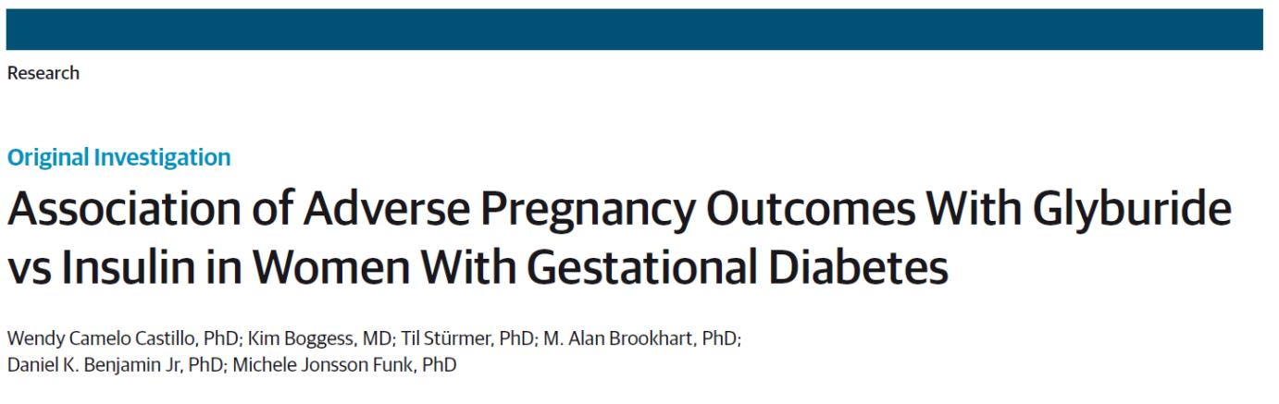
Motivating example
Gestational diabetes (GDM)
Glyburide (oral) vs Insulin (injection)
Effect on risk of infant born large for gestational age (LGA)

Slide 5
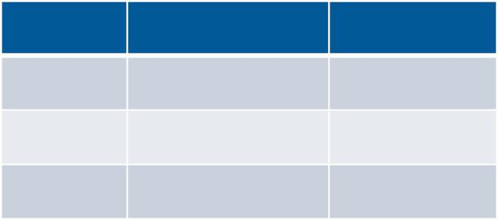
Hypothetical Example
Glyburide Insulin
LGA+
LGA-
400 (a) 400 (b)
8000 (c) 8000 (d)
8400 (m) 8400 (n)
Crude RR: 1.00 (0.87, 1.14)
Unmeasured confounder:
Obesity, a strong risk factor for LGA

Slide 6
Hypothetical Example
Glyburide Insulin
Bias Parameters
Effect of obesity on LGA (RR_{CD})=3.0
P(obese|glyburide)= p1 =0.25
P(obese insulin= p0 =0.50
LGA+
LGA-
400 (a) 400 (b)
8000 (c) 8000 (d)
8400 (m) 8400 (n)
Crude RR: 1.00 (0.87, 1.14)
Unmeasured confounder:
Obesity, a strong risk factor for LGA

Slide 7
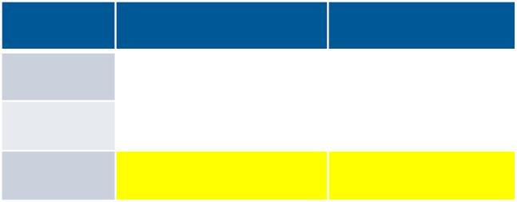
Hypothetical Example
Glyburide Insulin
Bias Parameters
Effect of obesity on LGA (RR_{CD})=3.0
P(obese|glyburide)= p1 =0.25
P(obese insulin= p0 =0.50
LGA+
LGA-
400 (a) 400 (b)
8000 (c) 8000 (d)
8400 (m) 8400 (n)
Obese subgroup
Glyburide
Insulin
B₁
M₁= m*p₁
LGA+
LGA-
A₁
C₁
M₁
M₁= 8400*0.25 = 2100
D₁
N₁
N₁= n*p₀
N₁= 8400*0.50 = 4200

Slide 8
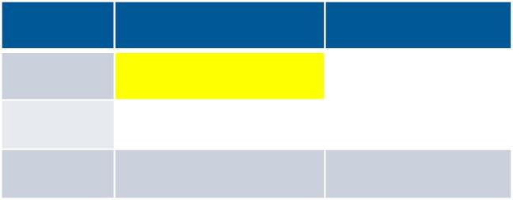
Hypothetical Example
Glyburide Insulin
Bias Parameters
Effect of obesity on LGA (RR_{CD})=3.0
P(obese|glyburide)= p1 =0.25
P(obese insulin= p0 =0.50
LGA+
LGA-
400 (a) 400 (b)
8000 (c) 8000 (d)
8400 (m) 8400 (n)
Obese subgroup
Glyburide
Insulin
B₁
A [RR *M *a] / [RR *M + m - M ]
1 =
CD
1
CD
1
1
LGA+
LGA-
A₁
C₁
A₁=
[3.0*2100*400]
[3.0*2100 + 8400-2100]
D₁
2100 (M ) 4200 (N )
1
1
A₁=
200

Slide 9
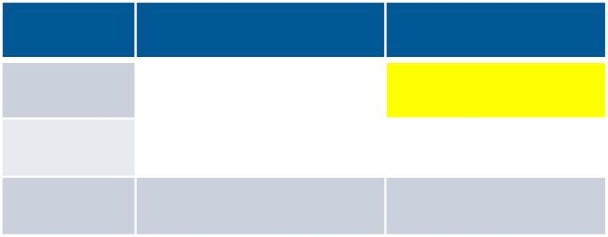
Hypothetical Example
Glyburide Insulin
Bias Parameters
Effect of obesity on LGA (RR_{CD})=3.0
P(obese|glyburide)= p1 =0.25
P(obese insulin= p0 =0.50
LGA+
LGA-
400 (a) 400 (b)
8000 (c) 8000 (d)
8400 (m) 8400 (n)
Obese subgroup
Glyburide
Insulin
B₁
B [RR *N *b] / [RR *N + n - N ]
1 =
CD
1
CD
1
1
LGA+
LGA-
200 (A₁)
C₁
B₁=
[3.0*4200*400]
[3.0*4200 + 8400-4200]
D₁
2100 (M ) 4200 (N )
1
1
B₁=
300

Slide 10
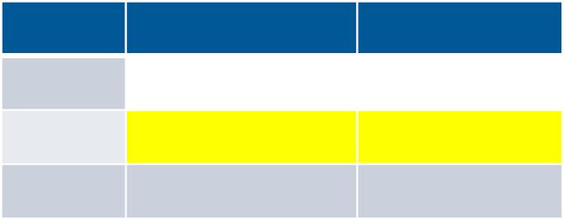
Hypothetical Example
Glyburide Insulin
Bias Parameters
Effect of obesity on LGA (RR_{CD})=3.0
P(obese|glyburide)= p1 =0.25
P(obese insulin= p0 =0.50
LGA+
LGA-
400 (a) 400 (b)
8000 (c) 8000 (d)
8400 (m) 8400 (n)
Obese subgroup
Glyburide
Insulin
300 (B₁)
D₁
C = M -A
LGA+
LGA-
200 (A₁)
C₁
1
1
1
C = 2100 - 200 = 1900
1
D = N -B
2100 (M ) 4200 (N )
1
1
1
1
1
D = 4200 - 300 = 3900
1

Slide 11
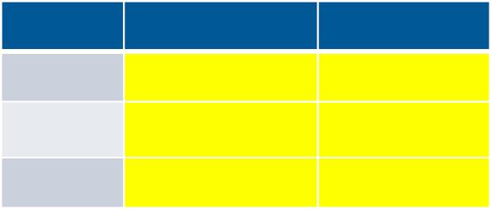
Hypothetical Example
Glyburide Insulin
Bias Parameters
Effect of obesity on LGA (RR_{CD})=3.0
P(obese|glyburide)= p1 =0.25
P(obese insulin= p0 =0.50
LGA+
LGA-
400 (a) 400 (b)
8000 (c) 8000 (d)
8400 (m) 8400 (n)
Obese subgroup
Non-Obese subgroup
Glyburide
Insulin
300 (B₁)
D₁
Glyburide
Insulin
B₀
LGA+
LGA-
200 (A₁)
C₁
A₀
C₀
D₀
2100 (M ) 4200 (N )
M₀
N₀
1
1

Slide 12
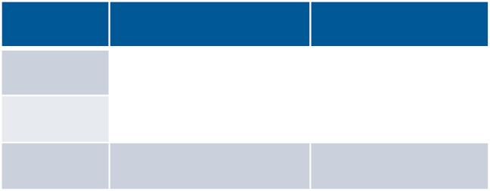
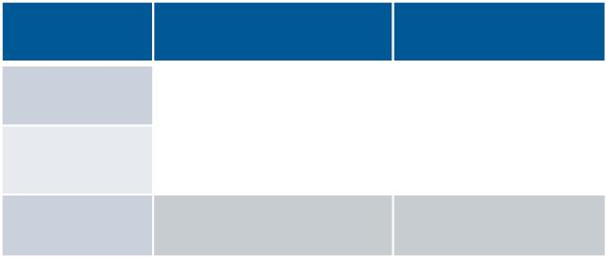
Hypothetical Example
Glyburide Insulin
Bias Parameters
Effect of obesity on LGA (RR_{CD})=3.0
P(obese|glyburide)= p1 =0.25
P(obese insulin= p0 =0.50
LGA+
LGA-
400 (a) 400 (b)
8000 (c) 8000 (d)
8400 (m) 8400 (n)
Obese subgroup
Non-Obese subgroup
Glyburide
Insulin
Glyburide
Insulin
LGA+
LGA-
200 (A₁)
300 (B₁) LGA+
200 (A ) 100 (B )
0
0
1900 (C ) 3900 (D ) LGA-
6100 (C ) 4100 (D )
1
1
0
0
2100 (M ) 4200 (N )
6300 (M ) 4200 (N )
1
1
0
0
RR = 1.33
RR_{non-obese} = 1.33
obese

Slide 13
Limitations
Assess bias due to a single unmeasured confounder at a time
No time-to-event outcomes
No control for other confounders
Does not adjust the confidence intervals on the estimate
Does not account for uncertainty in estimates of the bias parameters

Slide 14
Probabilistic bias analysis
Iterative form of SBA
Adjusts treatment effect point estimate & CI
When applied to individual data, can simultaneously adjust for other measured confounders (unlike SBA)

Slide 15
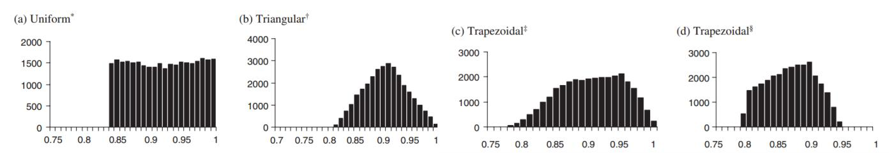
Probabilistic bias analysis
Moves individuals between levels of confounder without changing exposure or outcome.
A1 A0; B1 B0; etc
Requires estimates of
- Sensitivity and specificity OR
- Positive and negative predictive values
To adjust error term, need confidence intervals, standard errors, or educated guess about the distribution

Slide 16
Choosing an external validation study
Study population
- General vs condition specific
- Time period
- Setting
Data sources
- Administrative claims vs EMR vs registry
Algorithm for identifying covariate
- ICD-9, ICD-10, Read codes, free text, NLP
Size
Validation methods

Slide 17
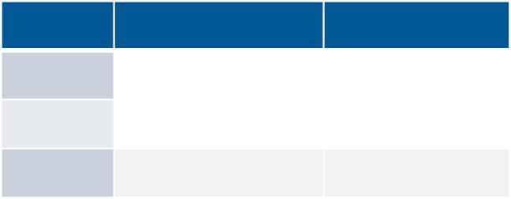
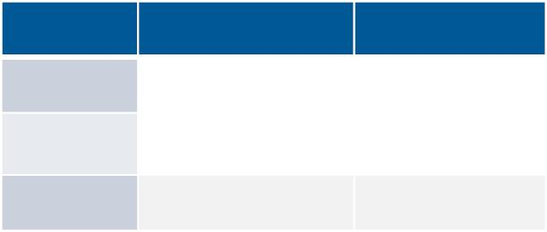
Hypothetical Example
Prevalence of ICD-9 Obesity: 8.8%
Crude estimate of glyruride -› LGA assn: 1.49
Effect controlling for ICD-9 Obesity: 1.46
ICD-9 Obese (C*)
ICD-9 Non-Obese (C*)
Glyburide
Insulin
Glyburide
Insulin
LGA+
LGA-
38 (A₁)
461 (C₁)
499 (M₁)
20 (B₁) LGA+
285 (D₁) LGA-
305 (N₁)
196 (A ) 114 (B )
0
0
4287 (C ) 3772 (D )
0
0
4483 (M ) 3886 (N )
0
0
RR_{obese*} = 1.16
RR_{non-obese*} = 1.49

Slide 18

Selected validation studies
Two relevant validation studies
Both in pregnant populations
- Neither specific to GDM
Estimates of sensitivity differ but specificity is high in both
Andrade 2011 Goff 2012
PPV
93 (92-96)
(nr)
Sensitivity 33 (32-35)
Specificity 99 (99-99)
15 (11, 20)
99.4 (98.7, 99.8)

Slide 19

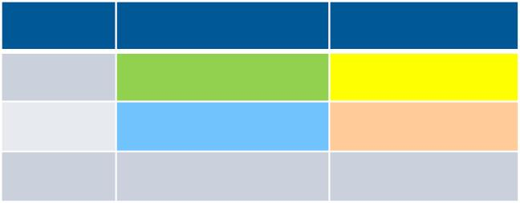
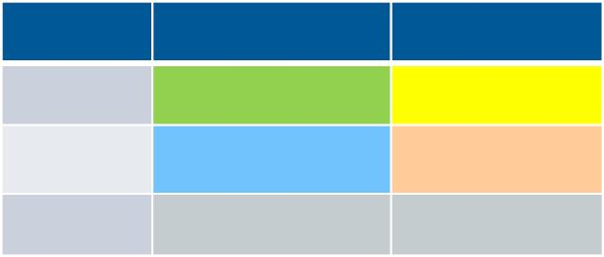
Selected validation studies
Near perfect specificity.
- All with ICD-9 code for 'obesity' will stay in the obese category
Poor sensitivity.
- Move some individuals without ICD-9 code for obesity into obese category
ICD-9 Obese (C*)
ICD-9 Non-Obese (C*)
Glyburide
Insulin
Glyburide
Insulin
LGA+
LGA-
38 (A₁)
461 (C₁)
499 (M₁)
20 (B₁) LGA+
285 (D₁) LGA-
305 (N₁)
196 (A ) 114 (B )
0
0
4287 (C ) 3772 (D )
0
0
4483 (M ) 3886 (N )
0
0

Slide 20
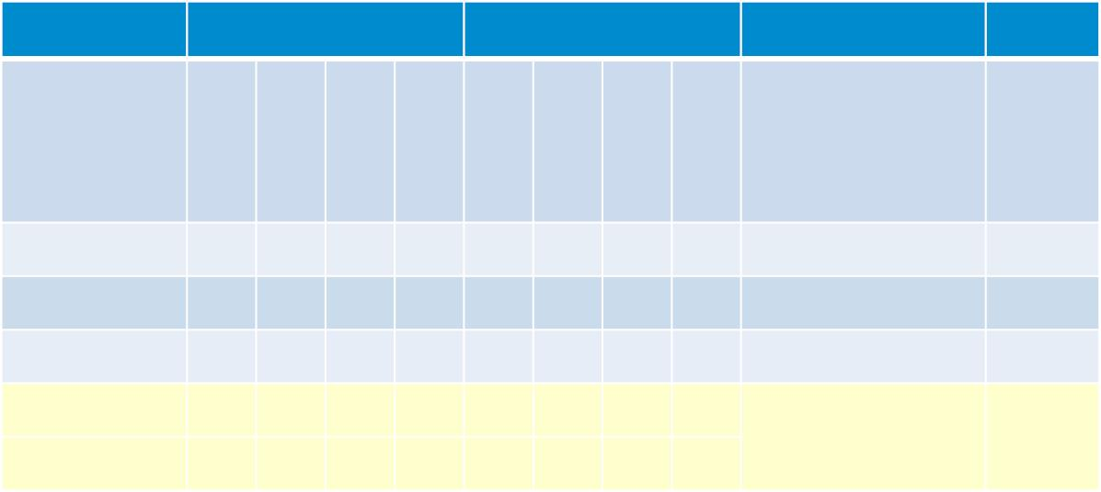
Probabilistic bias analysis (PBA) results
Sensitivity
Specificity
M
o
d
e
1
M
o
d
e
2
M
o
d
e
1
M
o
d
e
2
LGA
OR (2.5th, 97.5th)
Interval
width
(97.5 /
2.5)
M
i
n
m
a
x
M
i
n
m
a
x
Naïve
1.0 1.0 1.0 1.0 1.0 1.0 1.0 1.0 1.46 (1.17, 1.81)
.11 .15 .33 .35 1.0 1.0 1.0 1.0 1.45 (1.16, 1.78)
.11 .15 .33 .35 .90 .95 .99 1.0 1.45 (1.19, 1.84)
1.55
1.54
1.54
1.47
PBA 1
PBA 2
PBA 3: Y=1
Y=0
.5
.6
.8
.9
1.0 1.0 1.0 1.0 1.50 (1.24, 1.81)
.11 .15 .33 .35 1.0 1.0 1.0 1.0
Naïve:
PBA1:
PBA2:
PBA3:
Assumes perfect Se and Sp (no misclassified obesity)
Trapezoidal distribution for Se, non-differential misclassification
Trapezoidal distribution for Se and Sp, non-differential misclassification
Differential misclassification (better in those LGA+ than LGA-)

Slide 21
THANK YOU
Acknowledgement to Dr. Michele Funk, slides adapted from her presentation during ICPE 2020

